Slide 1
UNIT - 1

Slide 2
INTRODUCTION TO INDIAN FINANCIAL SYSTEM:-
Meaning, Functions, Structure & Components of Indian Financial System,
Financial System & Economic Growth,
Indicators of Financial Development,
Financial Sector Reforms in India &
Recent Development of Indian Financial System
UNIT OBJECTIVES:
The objectives of this unit are as under:
To Know Functions Of Financial System
To Understand Structure Of Indian Financial System
To Have Overview Of Role And Segments Of Financial Markets

Slide 3
Meaning, Functions, Structure & Components of Indian Financial System:
: Introduction & Meaning:
The economic development of any country largely depends on efficiency of the financial system. The well developed financial system helps economy to achieve growth in savings and investment. It also ensures proper functioning of financial intermediaries and facilitates flow of funds from surplus areas to deficit areas. The government as well as regulators implement suitable policies to make financial system more efficient and vibrant.
The financial system of any country is comprised of following components:
Financial Markets and Capital markets
Financial Intermediaries which includes banks & financial institutions
Financial services or products or instruments
Regulators including Government and Government appointed agencies.
The Indian Financial System is one of the most important aspects of the economic development of our country.
This system manages the flow of funds between the people (household savings) of the
country and the ones who may invest it wisely (investors/businessmen) for the betterment of both the parties.
According to Robinson- The primary function of the system is "to provide a link between savings and investment for the creation of new wealth and to permit portfolio adjustment in the composition of the existing wealth."

Slide 4
1.2 Functions Of Financial System:
Financial System performs the following Functions:
Mobilization of Savings :The financial system encourage individuals, corporate, and others to save for the purpose of economic development. The financial intermediaries play a significant role in mobilization of savings & making available funds to the entrepreneurs for investments. The household & corporate sectors saves through use of different financial products. For example, household sector uses bank deposit products & mutual funds products for the savings.
Ensures Liquidity: The financial system provides liquidity in respect of many financial assets like equity, debt instruments etc. This encourage investors to invest in financial assets. Indirectly this help corporate to raise funds from financial markets through issue of financial instruments. The financial system ensures liquidity for many of these financial assets through strengthening secondary market.
Settlement of Commercial Transactions: The financial system facilitates settlement of commercial transactions &
financial claims arising out of sale & purchase of goods & Services. For this money is used as an instrument which is legally recognized. Therefore values of all transactions including sale & purchase of goods and services are expressed in terms of money only. Over a period of time, the financial system has evolved other instruments like cheques, demand drafts, credit card etc. for settlement of economic transactions. These instruments are recognized by law as a substitute for money. In view of this, market participants use new instruments like credit and debit card as well as new facilities like internet banking and mobile banking for settlement of business and commercial transactions
Implementation of Economic Policies of Government: The presence of strong financial system helps the Government to frame appropriate economic policies for increasing savings & investment, achieving desired economic growth in industry and agriculture sector, etc. It also facilities government borrowings from the domestic market for meeting planned budgetary expenditures. It also helps Government to attract foreign capital for its investment in domestic market.
Support for Managing Risk in Financial Transactions: The financial system not only facilitates to execute business and commercial transactions but also helps to manage risk in such transactions. On account of deregulation of financial markets, participants are exposed to various market risk. The financial system offers various financial products like derivative etc. to manage risk in commercial transactions. The players who are part of financial system use variety of derivative products or financial contracts like forward futures, options and swaps to manage variety types of risk in commercial and business transactions.

Slide 5
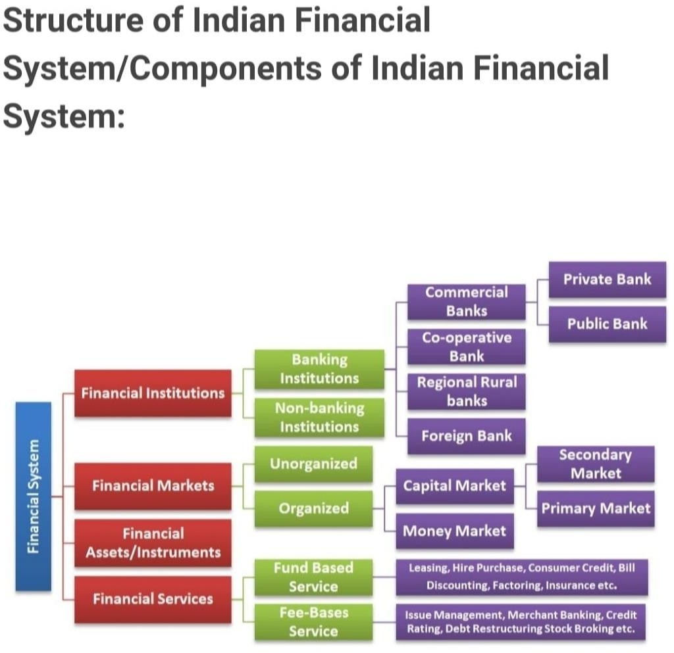
1.3: Structure & components of Financial System

Slide 6
Indian Financial System
The services that are provided to a person by the various Financial Institutions including banks, insurance companies, pensions, funds, etc. constitute the financial system.
Given below are the features of the Indian Financial system:
It plays a vital role in the economic development of the country as it encourages both savings and investment
It helps in mobilizing and allocating one’s savings
It facilitates the expansion of financial institutions and markets
Plays a key role in capital formation
It helps form a link between the investor and the one saving
It is also concerned with the Provision of funds
(I) Financial institutions:
Financial institutions are the participants in a financial market. They are business organizations dealing in financial resources. They collect resources by accepting deposits from individuals and institutions and lend them to trade, industry and others. They buy and sell financial instruments. They generate financial
instruments as well. They deal in financial assets. They accept deposits, grant loans and invest in
securities
Financial institutions are the business organizations that act as mobilizes of savings and as purveyors of credit or finance. This means financial institutions mobilize the savings of savers and give credit or
finance to the investors. They also provide various financial services to the community. They deal in financial assets such as deposits, loans, securities and so on. On the basis of the nature of activities,
financial institutions may be classified as:
Regulatory and Promotional Institutions
Banking institutions, and
Non-banking institutions.

Slide 7
Financial markets :
Financial markets are another part or component of financial system. Efficient financial markets are
essential for speedy economic development. The vibrant financial market enhances the efficiency of capital formation. It facilitates the flow of savings into investment. Financial markets bridge one set of financial intermediaries with another set of players. Financial markets are the backbone of the economy. This is because they provide monetary support for the growth of the economy. The growth of the financial markets is the barometer of the growth of a country’s economy. Financial market deals in financial securities (or financial instruments) and financial services. Financial markets are the centers or arrangements that provide facilities for buying and selling of financial claims and services.
Financial Instrument:
A Financial Instrument is defined as a contract between individuals/parties that holds a monetary value.
They can either be created, traded, settled, or modified as per the involved parties' requirement. In simple words, any asset which holds capital and can be traded in the market is referred to as a financial instrument.
Some examples of financial instruments are cheques, shares, stocks, bonds, futures, and options contracts.
Financial services:
Financial services can be defined as the products and services offered by institutions like banks of various
kinds for the facilitation of various financial transactions and other related activities in the world of finance like loans, insurance, credit cards, investment opportunities and money management as well as providing information on the stock market and other issues like market trends.
Financial services refer to services provided by the finance industry. The finance industry encompasses a broad range of organizations that deal with the management of money. Among these organizations are banks, credit card companies, insurance companies, consumer finance companies, stock brokerages, investment funds and some government sponsored enterprises.

Slide 8
2: Financial System & Economic Growth:
The financial system plays a crucial role in the economic development of our country. Businesses
and industries are financed by the financial system which lead to growth in employment and in turn increase
economic activity and domestic trade. Financial intermediaries help in improve investment efficiency, leading to hire economic growth.
Following are the roles of the financial system in the growth of country i). Savings-Investment Relationship:
The financial system helps efficiently direct the flow of savings and investments in the economy financial
instructions like banks a play a major role. They allow depositors invest money in various deposits by offering attractive rates of interest. These savings are then channelized by the banks to provide different credit to business entities.
Growth of Capital Markets:
Business entities require capital for funding business activates and production. Businesses require two kinds of capital: working capital & fixed capital. Therefore, various business entities use the financial system to
raise the funds for both short term and long term money requirements.
Foreign Exchange Market:
The Foreign Exchange Market helps exporters and importers raise and receive fund for settling transactions. It also enables banks borrow money and provides funds to different types of customers in various foreign currencies like Dollars and Euros.
Government Securities:
The Financial System enables the government raise fund, helping them borrow at a lower rate of interest. The state and the central government raise short term and long term funds from the government securities market, to financial capital requirements by issuing bills and bonds.

Slide 9
Infrastructure and Growth:
The Financial Infrastructure has a strong financial bearing on economic growth. The financial
Infrastructure signifies the financial assets, the financial market and the financial intermediaries which are the three main pillars of economy.
Financial services play a crucial role by providing funds for growth of infrastructure and
industry. The Financial Market provides the mechanism for trade in financial assets through
financial Intermediaries, by serving as a link between savers and investors and also facilitating the transfer of resources between them.
Trade Development:
The Financial system help in development of both domestic as well as foreign trade and also industry and commerce.
Employment Growth:
A properly functioning financial system helps generate more employment opportunities within the economy. The financial system helps provide funds to the growing business houses and industries, which results in an increase in production. It generates more employment opportunity for both the organized sector as well as unorganized sector. Increasing in business and industrial activity leads to various employment opportunity.
Venture Capital:
Startup have grown big time in India. The economic development of the country will be faster when more business ventures are funded and promoted.
Balances Economic Growth:
Economic development needs balanced growth which can be attained by propelling (boosting) growth in all sectors, simultaneously.

Slide 10
3. Indicators of Financial Development:
Development is about measuring how developed one country is compared to other countries, or to the same country in the past. Development measures how economically, politically, socially, culturally or technologically advanced a country is. There are a few indices and economic development indicators to measure development.
Per Capita Income
Gross Domestic Product (GDP)
Gross National Product (GNP)
Gross Domestic Income (GDI)
Gross National Income (GNI)
Inequality of wealth
Inflation
Unemployment
Per capita income
Per capita income or average income measures the average income earned per person in a given area (city,
region, country) in a given time period.
Total Income /Total Population
Higher per capita income means higher standard of living. So, developed countries have higher per capita income relative to developing countries.
Gross Domestic Product (GDP)
Gross domestic product (GDP) is a monetary measure of the value of all final goods and services produced in a period (quarterly or yearly). Also known as Nominal GDP. The economic worth of all goods and services produced in a given
year, adjusted as per changes in the general price level is known as Real GDP. Nominal GDP is the GDP without the
effects of inflation or deflation, whereas, we can arrive at Real GDP only after giving effects of inflation or deflation.

Slide 11
There is another formula for measuring
GDP GDP = C + I + G + Nx
C = Consumer Spending
I = Investment by Businesses G = Government Spending
Net Exports = Nx = (X- M) = Exports – Imports
Higher GDP also means higher standard of living. Thus, Developed countries have higher GDP.
Gross National Product (GNP)
Gross national product (GNP) is the market value of all the products and services produced in one year by labor and property supplied by the citizens of a country. It is equal to GDP plus any factor income earned by residents from overseas investments minus factor income earned within the domestic economy by overseas residents.
GNP = GDP + Net factor income inflow from abroad – Net factor income outflow to foreign countries.
Gross Domestic Income (GDI)
Factor income is income received from the factors of production i.e. land, labor, capital and organization. Factor income on
the use of land is called rent, income generated from labor is called wages , income generated from capital is called interest
and income earned by organization is called profit. Developed countries have higher GNP relative to developing countries. The sum of all income earned while producing goods and services within a nation's borders is called Gross Domestic Income (GDI)
GDI = rental income + interest income + profits + wages + income tax + dividends.
Developed countries have higher GDI relative to developing countries.
Gross National Income (GNI)
The gross national income (GNI) is the total domestic and foreign output claimed by residents of a country, consisting of gross domestic product (GDP) plus incomes earned by foreign residents, minus income earned in the domestic economy by nonresidents.
GNI = GDP + Net compensation receipts + Net property income receivable + Net taxes (minus subsidies). Developed
countries have higher GNI relative to developing countries.
For GNI calculation we have to includes Net taxes (minus subsidies) While GNP formula does not include it.

Slide 12

Inequality of wealth
Wealth inequality (also known as the wealth gap) refers to the unequal distribution of assets among residents of a country.
Wealth includes the values of homes, automobiles, personal valuables, businesses, savings, and investments. Developed countries have low wealth inequality.
Inflation
Inflation is an increase in the general price level of goods and services in an economy over a period of time. When the price
level rises, each unit of currency buys fewer goods and services. Consequently, inflation reflects a reduction in the purchasing power of the currency. Deflation is the decrease in the general price level of goods and services in an economy over a period of time. Inflation is caused when goods and services are in high demand, creating a drop in availability.
Consumers are willing to pay more for the items they want, causing manufacturers and service providers to charge more
Unemployment
Unemployment occurs when people who are without work are actively seeking work. The unemployment rate is a measure of the prevalence of unemployment and it is calculated as a percentage by dividing the number of unemployed individuals by all individuals currently in the labor force.
(No. of unemployed people /No. of people in labor force) x 100
Labor Force is all people who supply labor for the production of goods and services during a specified period. It includes both the employed and the unemployed. Developed countries have relatively low unemployment rate.

Slide 13
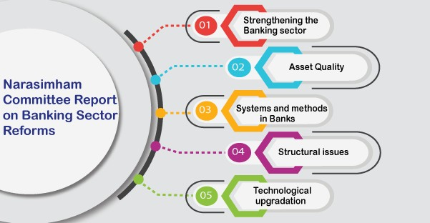
4. Financial Sector Reforms in India
The main intent of banking sector reforms was to uphold a diversified, efficient and competitive financial system with the aim of improving the allocative efficiency of resources through operational flexibility, improved financial viability and institutional solidification.
As early as August 1991, the government selected a high level Committee on the Financial System (the Narasimham Committee) to look into all facets of the financial system and make comprehensive recommendations for improvements.

Slide 14
The major reforms relating to the banking system were:
Capital base of the banks were strengthened by recapitalization, public equity issues and subordinated debt.
Prudential norms were introduced and progressively tightened for income recognition, classification of assets, provisioning of bad debts, marking to market of investments.
Pre-emption of bank resources by the government was reduced sharply.
New private sector banks were licensed and branch licensing restrictions were relaxed.
Similarly, several operational reforms were introduced in the area of credit policy:
Detailed regulations relating to Maximum Permissible Bank Finance were abolished.
Consortium regulations were relaxed substantially.
Credit delivery was shifted away from cash credit to loan method.

Slide 15
5. Recent Growth/ Development in Indian financial system:
1. Nationalisation of financial institutions:
RBI, the leader of the financial system, was established in 1935. It was nationalized in 1949.
Insurance Corporation of India came into existence on 1st September, 1956.
Another important development was the nationalisation of 14 major commercial banks in 1969. In 1980, 6 more banks were nationalized. Another landmark was the nationalisation of general insurance business and setting up of General Insurance Corporation in 1972.
2. Growth of the banking sector
Being one of the most extensive, the entire Indian banking system has a total asset value of approximately 270 billion with total deposits being around 220 billion.
The banking system in India is continuously advancing and tranforming itself.
The current development of Core banking, Internet banking e.t.c. has made banking operations easy and customer friendly.
3. Establishment of institution for housing finance:
The National Housing Bank (NHB) has been set up in July 1988 as an apex institution to mobilise resources for the housing sector and to promote housing finance institutions.

Slide 16
4. Establishment of Development Banks:
Development of Indian financial system is the establishment of new financial institutions to supply
institutional credit to industries.
In 1949, RBI undertook a detailed study to find out the need for specialized institutions. The first development bank was established in 1948. That was Industrial Finance Corporation of India (IFCI).
The Industrial Credit and Investment Corporation of India (ICICI) were set up in 1955. It was supported by Government of India.
The UTI was established in 1964 as a public sector institution to collect the savings of the people and make them available for productive ventures.
Industrial Development Bank of India (IDBI) was established on 1st July 1964. Industrial Investment Bank of India (IIBI).
On April 2, 1990 the Small Industries Development Bank of India (SIDBI)
5. Establishment of Institution for Agricultural Development:
In 1963, the RBI set up the Agricultural Refinance and Development Corporation (ARDC)
National Bank for Agriculture and Rural Development (NABARD) was set up in 1982. The main objective of the establishment of NABARD is to extend short term, medium term and long term finance to agriculture and allied activities.

Slide 17
Establishment of Stock Holding Corporation of India (SHCIL): In 1987, another institution, namely, Stock Holding Corporation of India Ltd. was set up to strengthen the stock and capital markets in India. Its
main objective is to provide quick share transfer facilities, clearing services, support services etc. to investors.
Establishment of mutual funds and venture capital institutions: Mutual funds refer to the funds raised by financial service companies by pooling the savings of the public and investing them in a diversified portfolio.
Venture capital is a long term risk capital to finance high technology projects. The IDBI venture capital fund was set up in 1986. The ICICI and the UTI have jointly set up the Technology Development and Information Company of India Ltd. in 1988 to provide venture capital.
Growth of the Capital Market in India:
The capital markets in India have also witnessed changes. Some of them are-
Stock exchanges facing privatisation.
Removal of ill-used forward trading mechanism
In order to serve different investors in different locations, the introduction of infotech systems in National
Stock Exchange.
The increase in the ratio of transaction with deposit system and share ratio.

Slide 18
9. Growth in the Insurance sector in India
The market potential in India is immense. But it is untapped. So now in order to utilise this opportunity,
both foreign and Indian private players are providing tailor made products with opening of the market.
Because of huge competition and entry of new players, the insurance sector has also witnessed
innovations like innovative insurance based products, services and asset value etc.
Many foreign companies like New York Life, Aviva, Standard Life have also entered this sector.
Now a days, the insurance companies are engaged in aggressive marketing, selling and distribution
techniques because of the extreme competition that they face from each other..
The credit for the development of this sector also goes to the active part of the regulatory body – Insurance Regulatory and Development Authority.

Slide 19
10. Growth of the Venture Capital market in India
Inspite of the hindrances by the external setup, the venture capital sector in India is a very active financial sector.
In India, currently, there are around 2 international and 34 national venture capital funds registered by SEBI.
The growth of financial sector in India at present is nearly 8.5% per year. The rise in the growth rate suggests the growth of the economy. The financial policies and the monetary policies are able to sustain a stable growth rate.
The reforms pertaining to the monetary policies and the macro economic policies over the last few years has influenced the Indian economy to the core. The major step towards opening up of the financial market further was the nullification of the regulations restricting the growth of the financial sector in India. To maintain such a growth for a long term the inflation has to come down further.
The financial sector in India had an overall growth of 15%, which has exhibited stability over the last few years although several other markets across the Asian region were going through a turmoil. The development of the system pertaining to the financial sector was the key to the growth of the same. With the opening of the financial market variety of products and services were introduced to suit the need of the customer. The Reserve Bank of India (RBI) played a dynamic role in the growth of the financial sector of India.

Slide 20
Presented By:
Vaishali Chauhan
(Malla Reddy University, Hyderabad)
Thank You…

